Slide 1
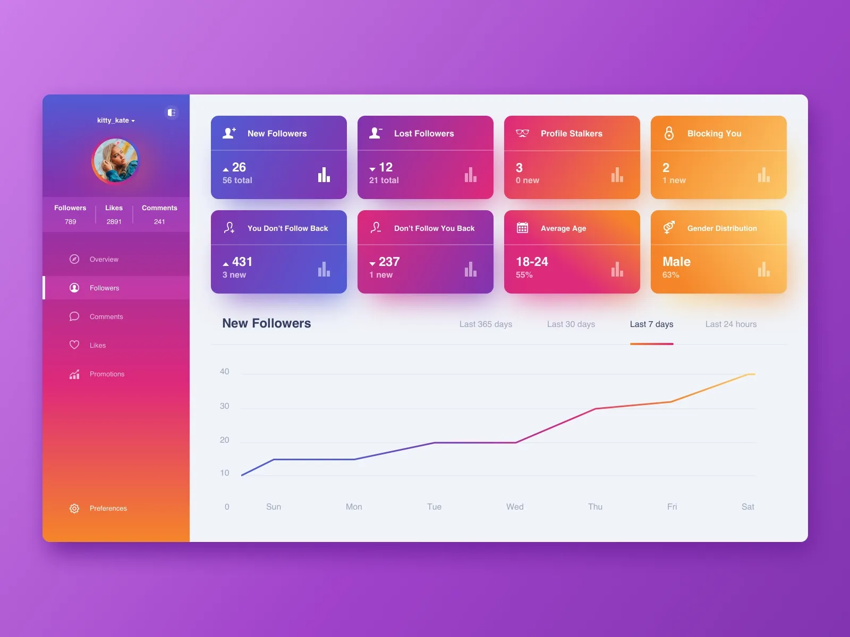
Instagram Performance Analytics for Sugar Cosmetics

Slide 2
Problem Statement:
Analyze Sugar Cosmetics' Instagram performance and design an interactive Tableau dashboard to recommend strategic social media decisions.
Project Objectives:
Evaluate the performance of Sugar Cosmetics' Instagram account based on engagement and reach.
Identify trends in content performance (e.g., posts, reels, stories).
Determine the best-performing content types, hashtags, and posting times.
Analyze audience demographics and growth trends.
Provide data-driven insights to refine and support social media strategy.

Slide 3
Business Use Cases:
Identify high-performing content types and posting days
Understand audience engagement patterns across time
Compare post formats (image, video, carousel) to optimize content creation
Assist the marketing team in maximizing ROI from organic social media posts
Recognize successful hashtags or campaigns based on user interaction
Evaluate account growth or stagnation over time

Slide 4
Approach:
Excel – Data Preprocessing
Load raw data into Excel.
Clean up inconsistencies (null values, date formats, duplicate entries).
Normalize Phase specific fields (e.g., Post date and post type and impressions).
Conduct exploratory data summaries (pivot tables, filters).
After cleaning making a insightfull dashboard.

Slide 5
Results:
Cleaned, structured database for analytics
Interactive dashboard showing all KPIs and metrics
Insights into Post Date, Post Type (e.g., Image, Video, Carousel)
Likes, Comments, Shares, Saves, Reach, Impressions, Hashtags and Caption

Slide 6
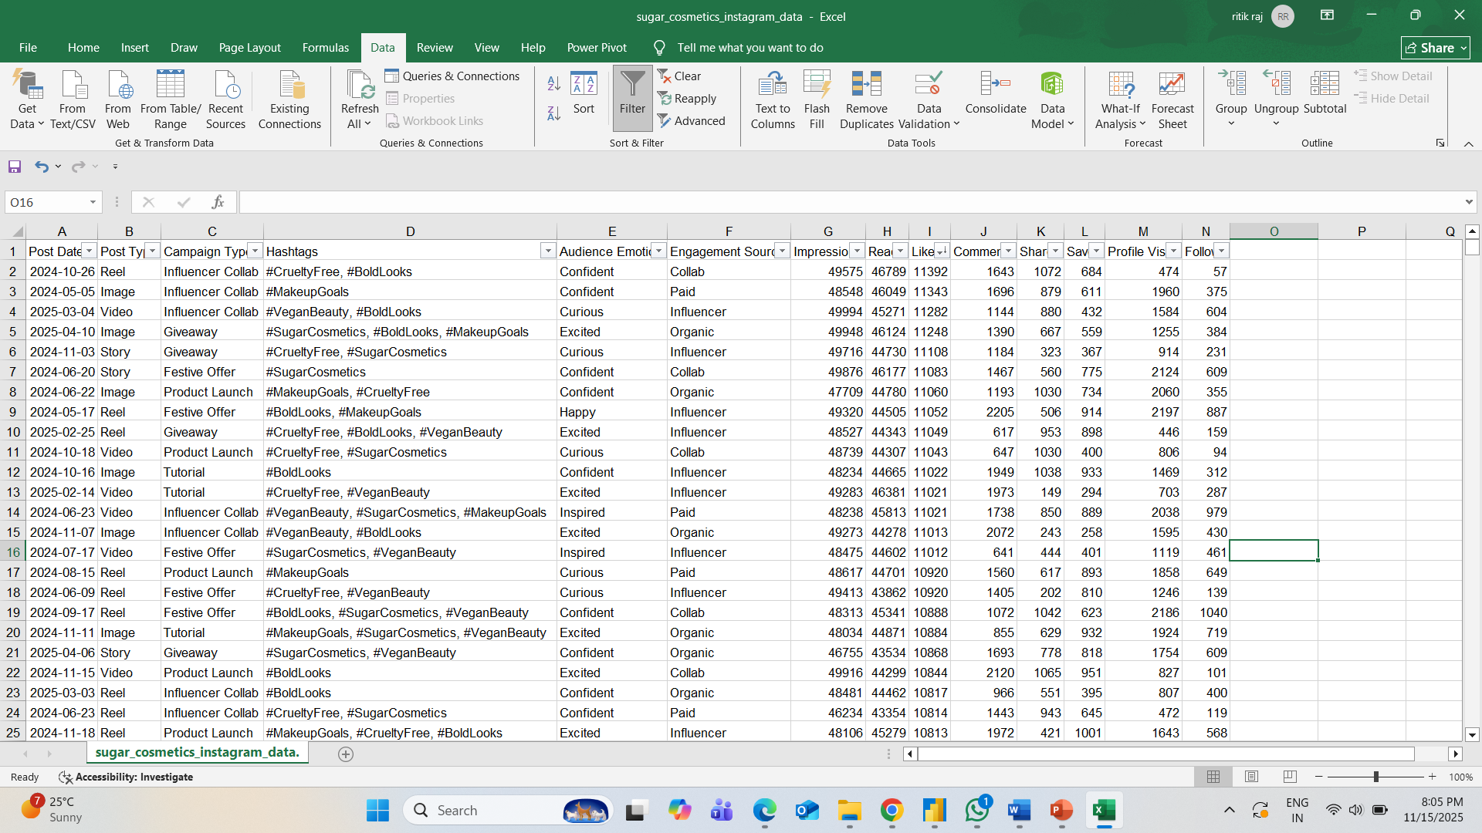
Excel Workbook:

Slide 7
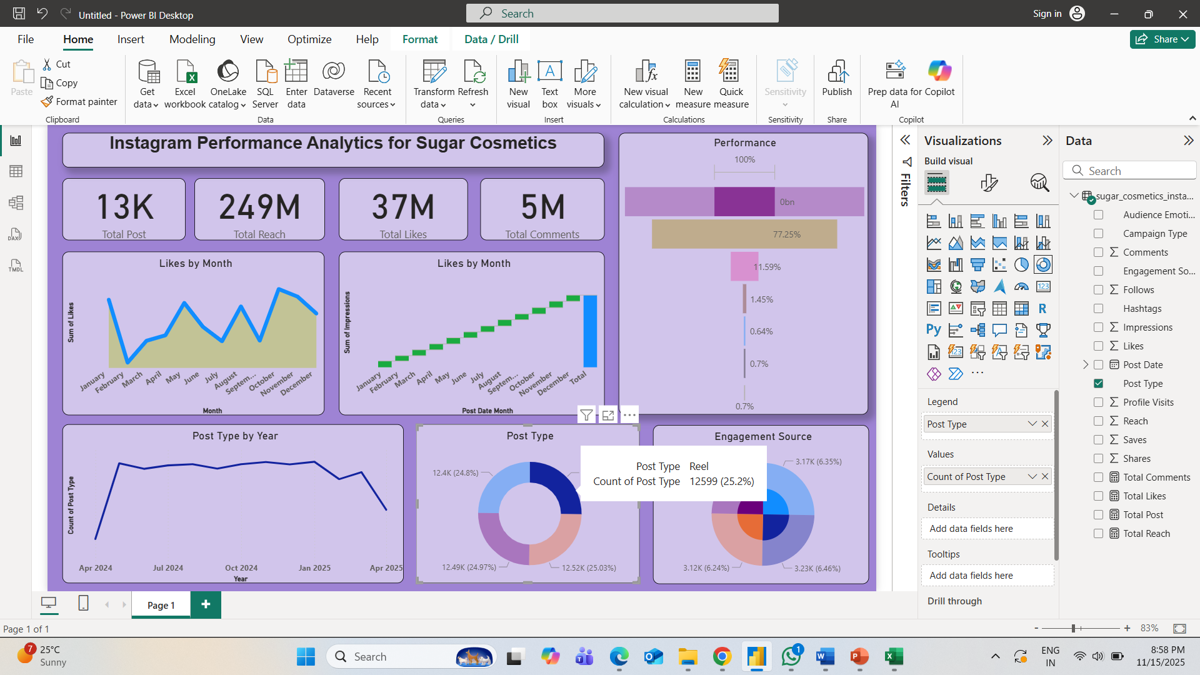
Dashboard on Reels:

Slide 8
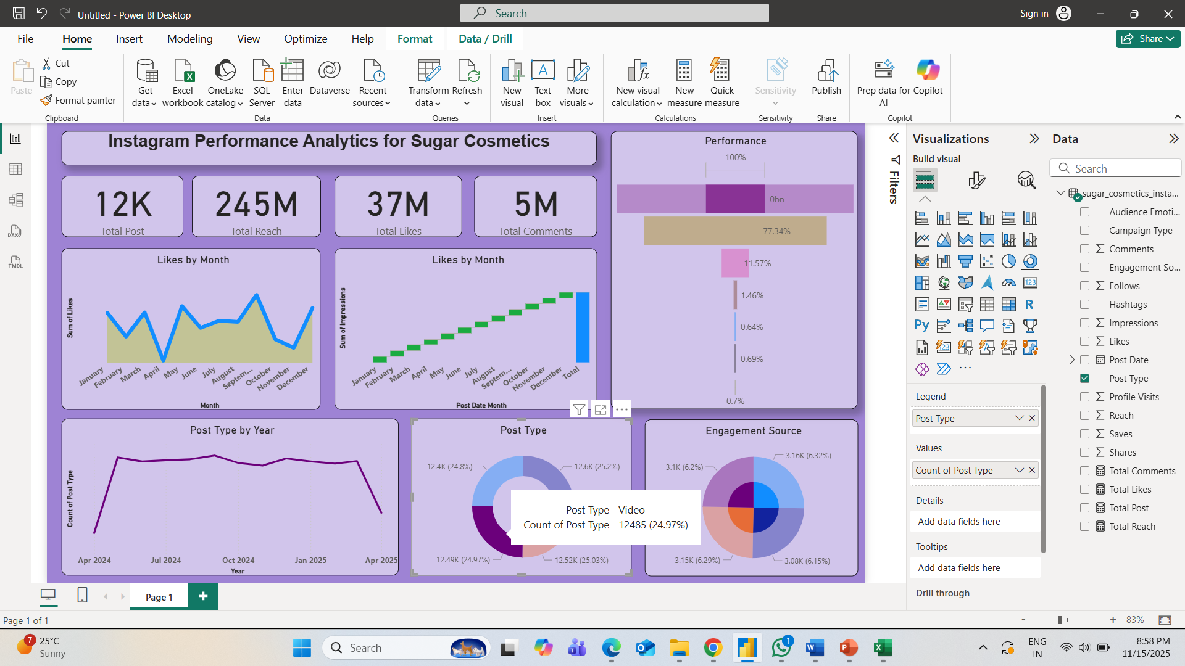
Dashboard On Video:

Slide 9

Dashboard on Story:

Slide 10
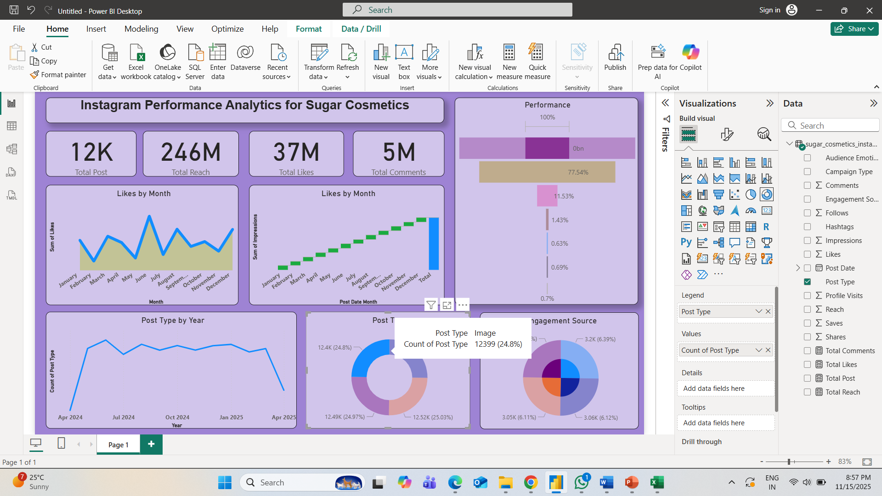
Dashboard on Images:

Slide 11
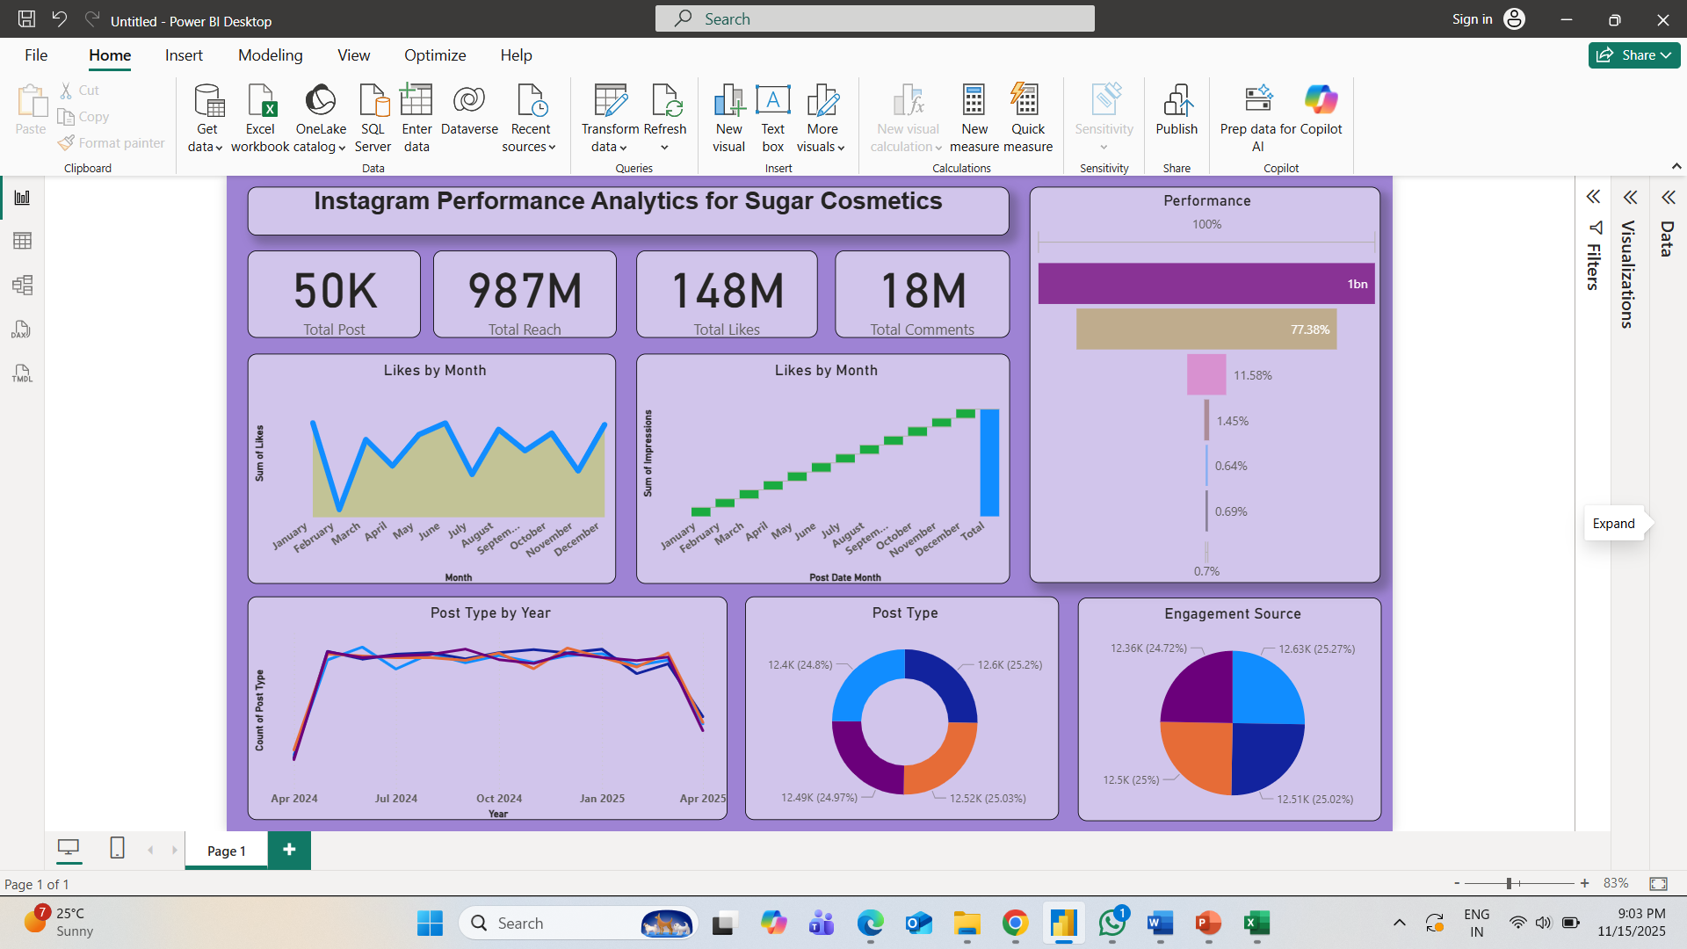
Main Dashboard

Slide 12
Thank You

